Slide 1

Dr Jacqueline Baxter
The Open University
Walton Hall
Milton Keynes
MK7 6AA
Jacqueline.Baxter@open.ac.uk

Slide 2


Changing knowledges; changing frameworks: challenges for inspection as a governing tool, in
England, Scotland and Sweden
Jacqueline Baxter –
The Open University UK
Jacqueline.baxter@open.ac.uk

Slide 3
Method
60 interviews with : contract inspectors, HMI, school leaders, leaders in education
5 Case studies in each country.
Documentary analysis of 300 school inspection reports in each country.
Use of nvivo + discourse analysis (Wodak, 2001, Goffman , 2002;Berger 2011)
Research challenge: very diverse political, social and economic contexts in each country.
Why do inspection frameworks and what counts as knowledge within them change so radically ?

Slide 4
Rationale
Inspectors
Enact knowledge; data, inspection reports, etc.
Encode knowledge; deciding what is relevant
Embody knowledge
-As governing has changed to become more networked, less bureaucratic, more flexible and interrelated so has knowledge.
-Changes have the effect of reconstituting knowledge as a policy-forming rather than policy –informing activity (Issakyan et al 2008, Ozga et al 2010)
-In terms of inspection this implies knowledges required, produced by and enacted through inspection
Inspection
Notes:
Enact through credibitly of inspectors , what counts as knowledge in inspection

Slide 5
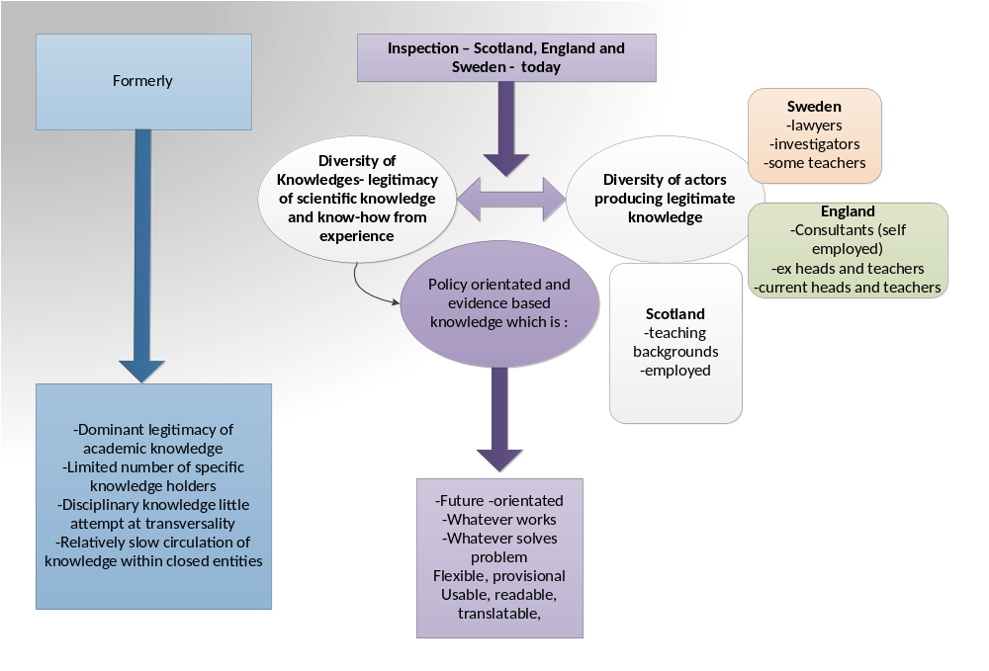
Schools
Ozga & Baxter, 2013)

Slide 6
The Governing work of inspectorates
‘All evaluation is a form of persuasion’ (House; 1980:71
‘Evaluations themselves can be no more than acts of persuasion. Although sometimes evaluators promise Cartesian proof, the certainty of proof and conclusiveness that the public expects : the definitive evaluation is rare…subject to any serious scrutiny evaluations always appear equivocal.’(House,1980:72)
‘I thought at first, given a set of criteria anyone could do that , then after a while I realised it was all down to communication :the skill was in the communication.’ (EP11)
Who are we persuading ?

Slide 7
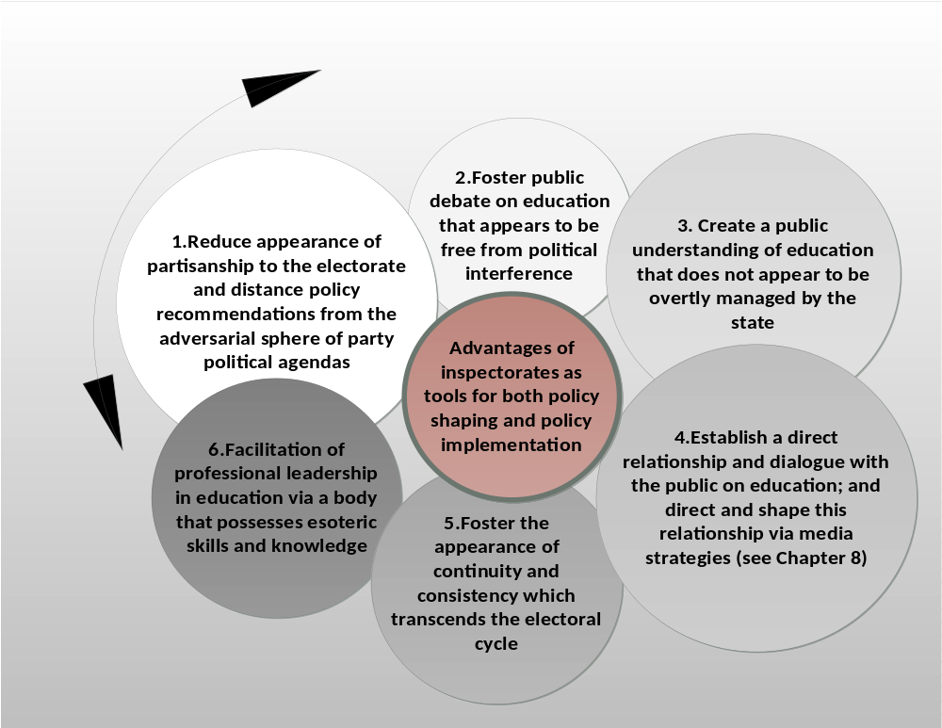
Flinders,M (2008:113)

Slide 8
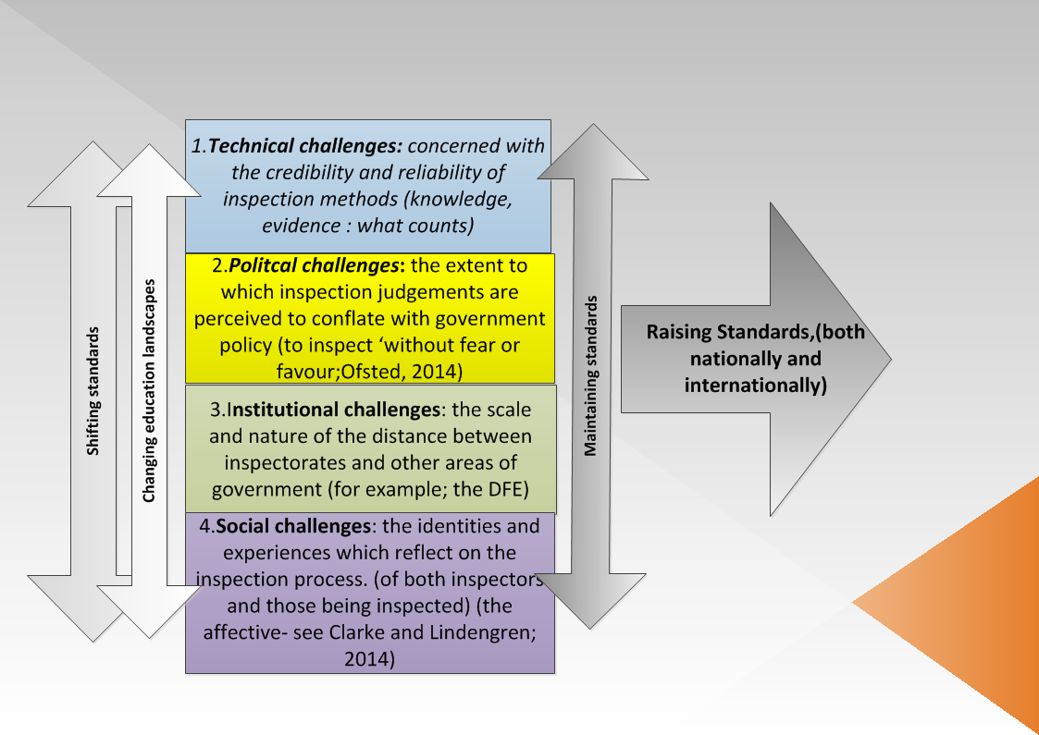

Slide 9

A very English Inspectorate: the “parents’ friend ?” (Major,J;1991)
England | Scotland | Sweden
The ‘parents’ friend’ aimed at transparent approach to education – opening up the secret garden….. Vast remit since Every Child Matters. Contract agencies: Tribal, Serco and CFBt overseen by HMI Inspect teaching; monitor compliance and inspect governance alongside leadership. (since 2009) 2012 New Framework /new emphasis on teaching and learning –on employing teachers as inspectors. ‘Farewell to the tick box inspector.’ (Baxter & Clarke, 2013)- return to HMI principles and professionalism Satisfactory judgement became ‘requiresimprovement.’reflecting the neoliberal journey to excellence. (Clarke, 2011) Mix of accountabilities suffering from MAD ? ( Johnathan Koppell, 2005) | Focus on European-wide models (Grek et al,2010) Exchange of experience and good practice Originally more policy active but scapegoated for exams fiasco in 2002 (Raffe,2005) Election of minority SNP government in 2007 – inspectorate as ‘teachers of good practice within Scotland and Europe’. Centres upon the governing narrative of the SNP: ‘inspection provides the mirror of a national perspective ‘(HMIE02). Major shift in 2011 when inspectorate became part of Education Scotland. (NIM) bringing inspectorate together with learning and teaching Scotland. Inspectors trained in ‘soft skills of interpersonal via psychologists.The school as a learning organisation/ an economically viable option reflecting European policy | NAE- strategy of not intervening in school activities and halting at municipal level rendered it a politically weak tool. Re-building began in 2002 based on notions of equivalence. The Swedish National Agency for School Improvement (Myndigheten fӧr skolutveckling) –mandated to inspect for compliance and quality of education.- to provide a robust basis for national and municipal decision making. Conservative liberal , centre and CD coalition established SSI 2008- Punitive approach Concerns about credibility of inspectors, capture and reliability of methods. Scale up of inspections (41%) 2011 due to ‘failing system’. Inspectors trained in legal or investigative skills.
International comparisons

Slide 10
Changing structures : changing forms of knowledge-preserving a balance between market and public interest (Wilkinson; 2013)
The ability to convince: to be credible
Proxmity but ‘not capture’
School knowledge
What counts as evidence ?
Presenting a convincing judgement
Core interests : the public? the student? the company? The inspectorate?
Past discourses of inspection? The spectres from the past
‘….so you get tied up in these knots and in the end what inspectors are doing is saying ok well I have to follow this rule….there isn’t a rule but I have to follow it….’ (EP 12).
‘now if Ofsted/HMI say no we are not signing it off, then it becomes a key performance indicator failure for the provider, so they are paranoid about this because they get slapped: you get contract action notices that will say, that unless you improve this will happen,’ EP12)

Slide 11
Summary
In governing terms, we note a contrast between the disciplinary regime of Ofsted, and the self-disciplining regime promoted by Education Scotland., and how these align to the political projects in both countries
The new processes in each country are demanding new skills and knowledges from inspectors in each.
Each inspection regime is suffering to a certain extent from what Clarke calls ‘Performance Paradoxes; emerge as regulatory bodies strive to represent the public interest in increasingly complex and dispersed systems of public provision (Clarke, 2008:125)
In England, Ofsted’s attempts to incorporate a professional discourse into a strongly disciplinary and centralising regime are weakened by absence of trust, while its increased alignment with political agendas also undercuts the mobilisation of references to professionalism.
All three regulatory regimes face governing problems: what our research demonstrates is that the knowledge basis of inspection’s claims to authority is not static, and changes according to the definition of the problems it is asked to address. These vary, but they are always governing problems privileging different knowledges.

Slide 12
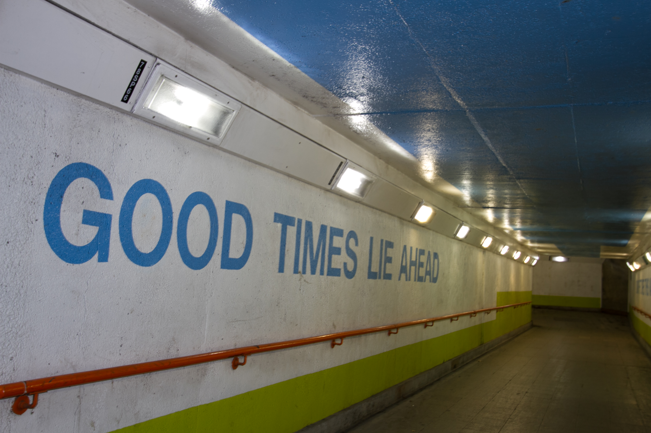
Governing by inspection (Grek & Lindgren, 2014) Forthcoming – Routledge
www.governingby inspection. com

